Slide 1
Ratios and Proportions

Slide 2
6.RP.1
6.RP.2
6.RP.3
Standard: Understand the concept of ratio language to describe a ratio relationship between two quantities; write a ratio and unit rate
I can… use and write ratio language to describe the relationship between two quantities; use words to describe unit rate
Bridge/Scaffold (Why?)
By learning ratios and proportions, students will better grasp how to work with fractions and percents, greatest common factor and multiplication

Slide 3
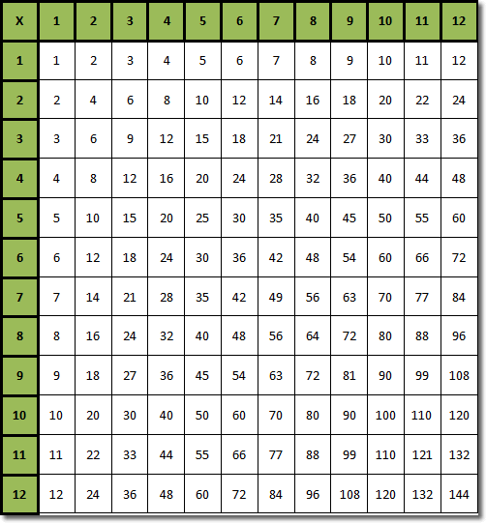

Slide 4
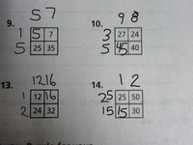
Factor Puzzle

Slide 5
Ratio

Slide 7
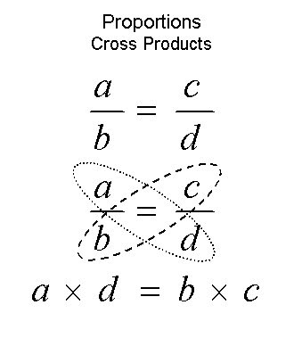

Slide 8
Percents

