Slide 1
In Math!

Slide 3
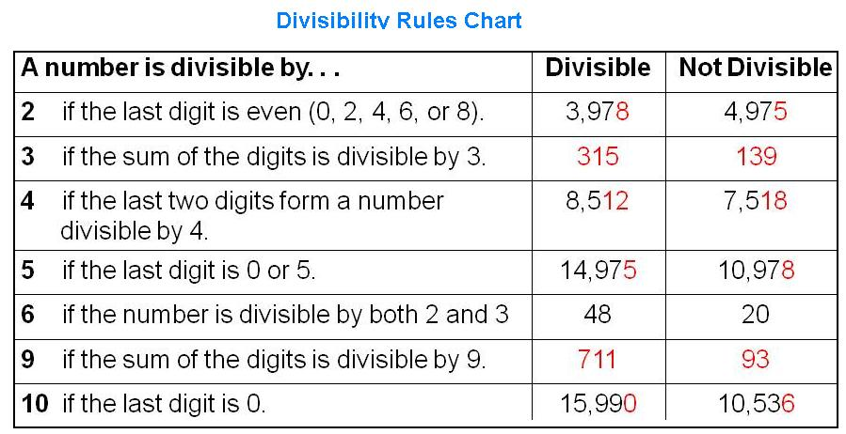

Slide 4
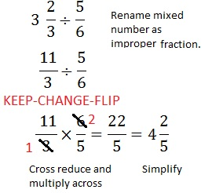

Slide 5
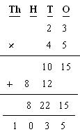

Slide 6
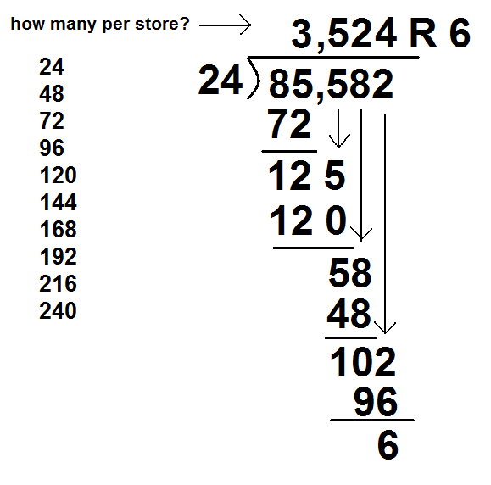

Slide 7
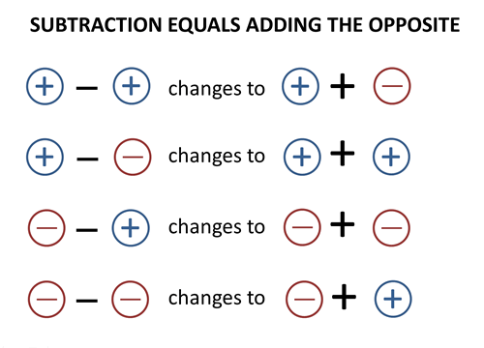

Slide 10
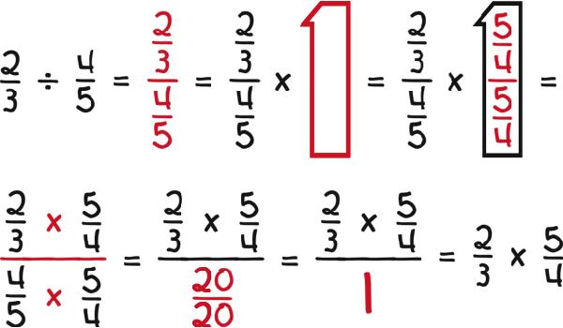
#1 in Disguise

Slide 11
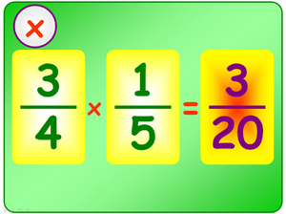
Multiply Integers

Slide 12
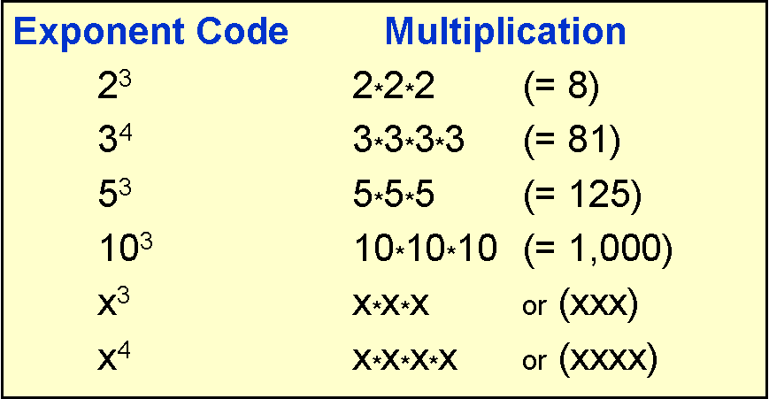

Slide 13
Associative Property

Slide 14
Commutative Property

Slide 15
Distributive Property

Slide 17
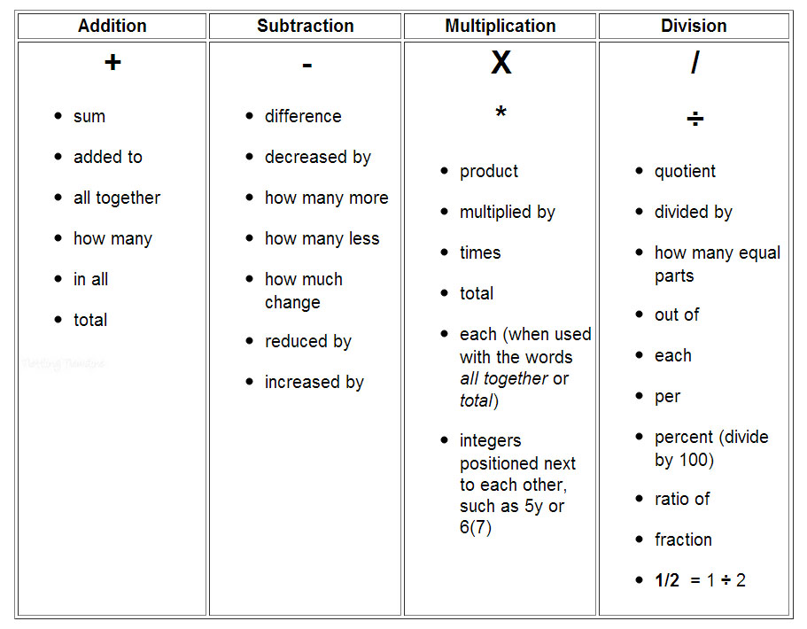
*Tax
*Tip
*Discount
*Coupon

Slide 18
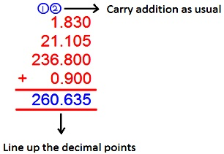

Slide 19
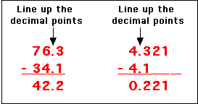

Slide 20
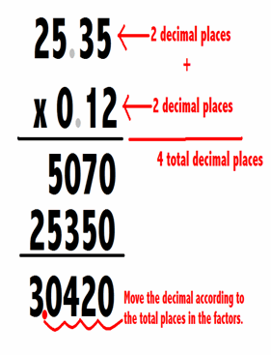

Slide 21
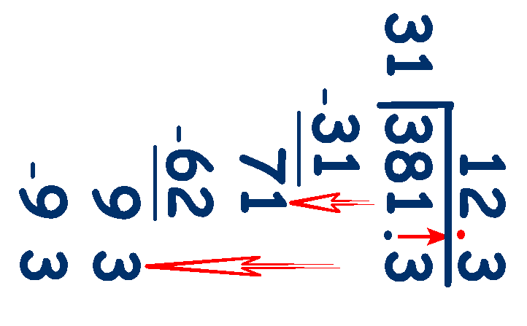

Slide 22
What does it Mean?
- ( - 3 ) = +3
-1 times - 3

Slide 23
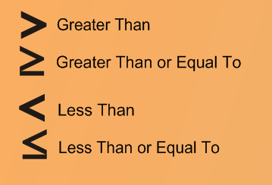
Inequalities

Slide 24
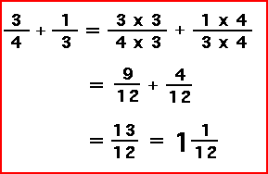
Adding Fractions Unlike denominators

Slide 25
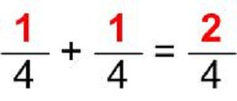
Adding Fractions Like denomiators

Slide 26
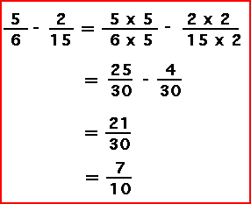
Subtracting Fractions Unlike denominators

Slide 27
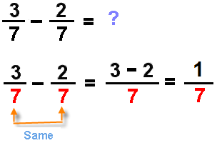
Subtracting Fractions Like denominators

