Slide 1
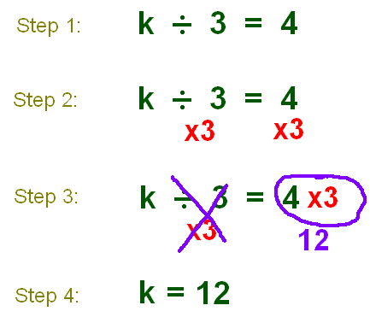
Division of Equations

Slide 2
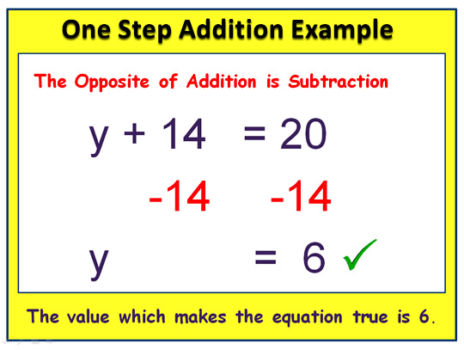

Slide 3
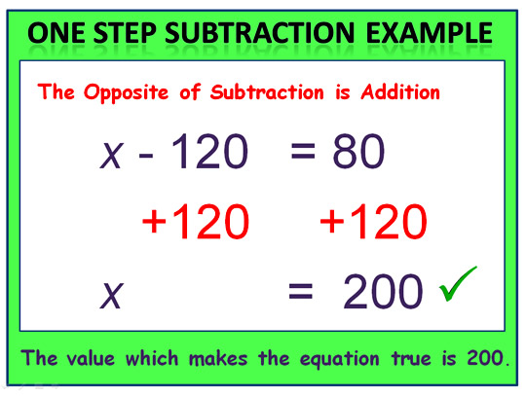

Slide 4
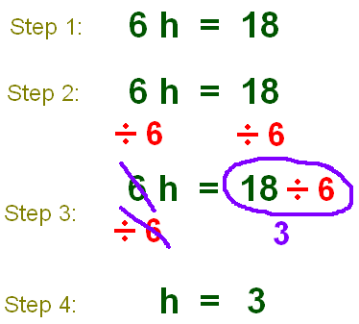
Multiplication of Equations

Slide 5
Golden Rule
What you do to one side, you must do to the other

Slide 6
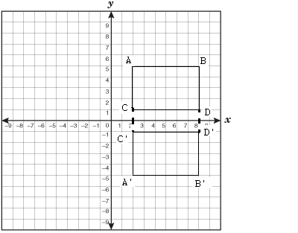
Graphing Reflections

Slide 7
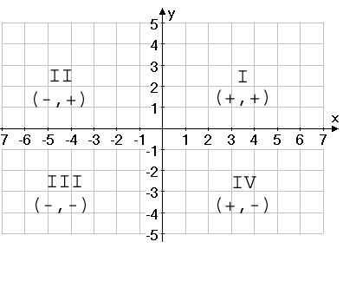
Graphing Quadrants

Slide 8
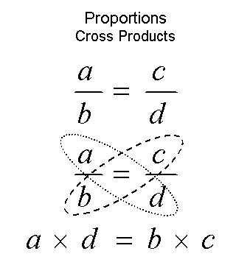

Slide 9

Ratio

Slide 10
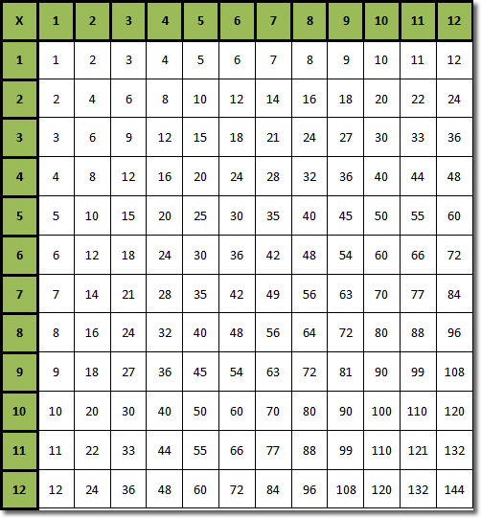

Slide 11
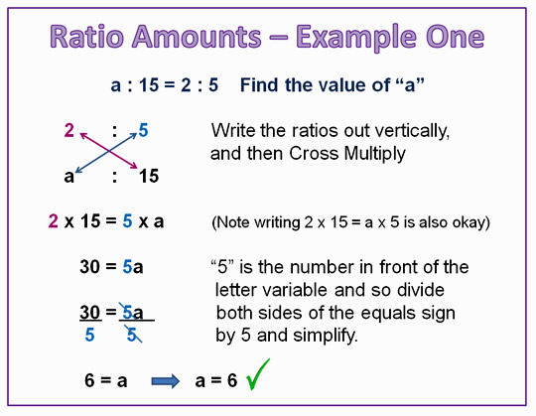

Slide 12
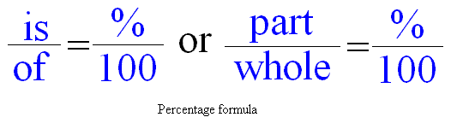
Percents

Slide 13
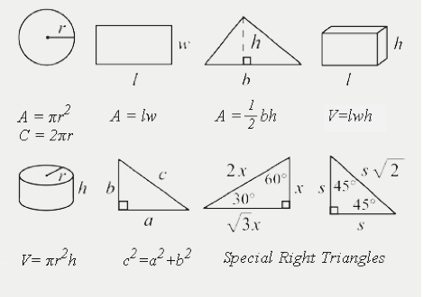
Geometry

Slide 14
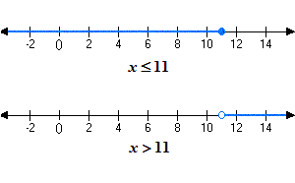
Graphing Inequalities

Slide 15
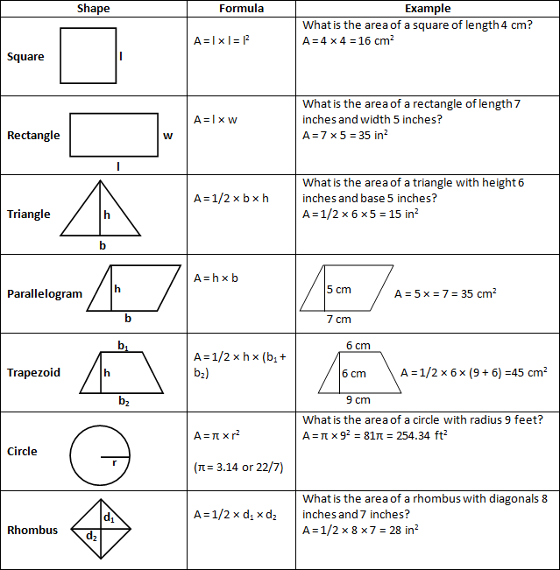
Geometry

Slide 16
Area
b x h

Slide 17
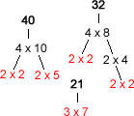
Prime Factorization
40 = 2 x 5
32 = 2
21 = 3 x 7

Slide 19
Be a Doctor of Thinkology
TODAY!!

