Slide 1
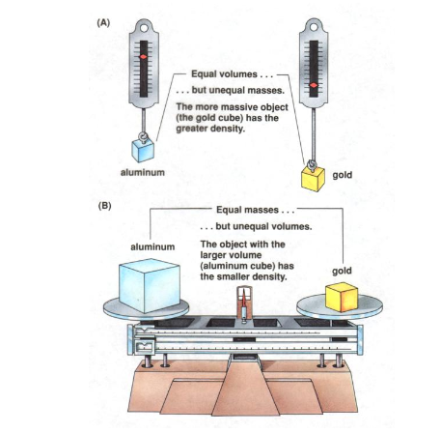

Slide 2
Elements, Compounds and Mixture
http://www.pbslearningmedia.org/asset/lsps07_int_theatom/

Slide 3
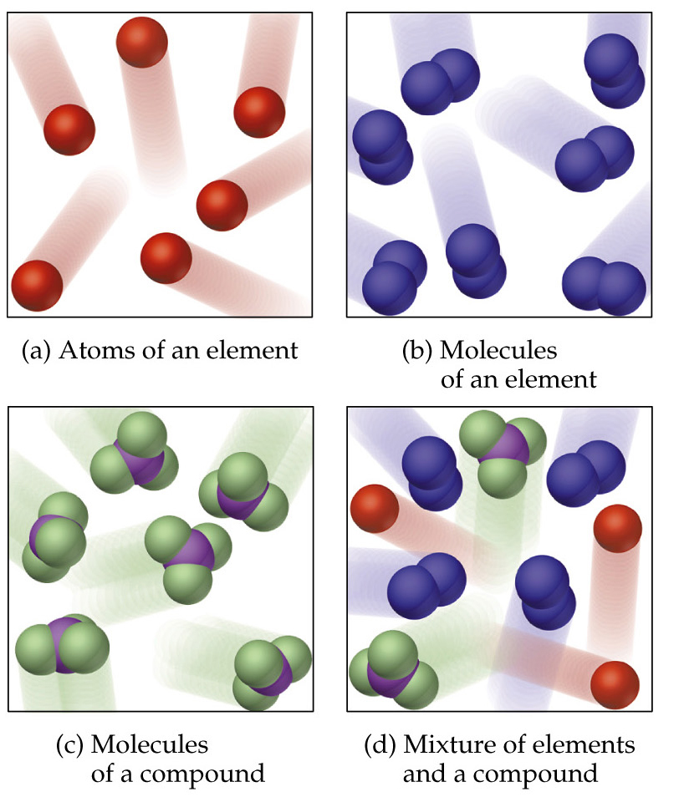
Classification of Matter
Matter is a substance that occupy space and has mass.
Matter can be classified into
i. Pure Matter
ii. Impure Matter

Slide 4
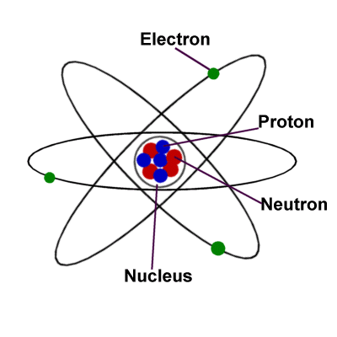
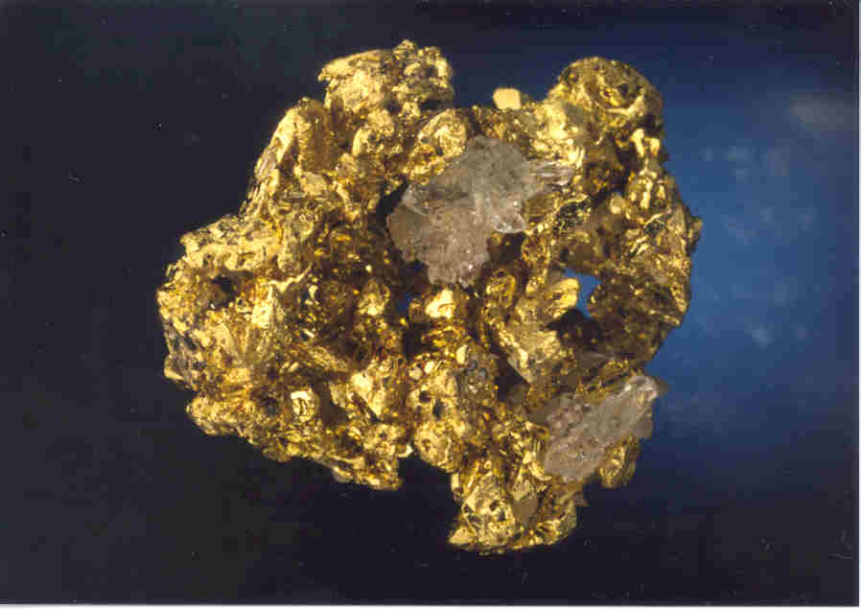
What is an atom and element?
An atom is the smallest particle of a pure substance.
Element is a pure substance made up of one type of atom. It cannot be separated into a simpler substance by physical or chemical means.
http://www.chem4kids.com/files/matter_intro.html
Watch video

Slide 5
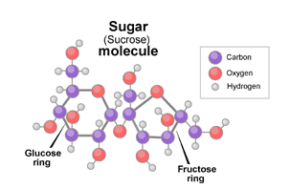
Elements, compound and mixture
https://www.youtube.com/watch?v=MaZ7lsc5ub8
A pure substance has a definite and constant composition — like salt or sugar. A pure substance can be either an element or a compound, but the composition of a pure substance doesn’t vary.
The white stuff we know as sugar is sucrose, a molecule composed of 12 atoms of carbon, 22 atoms of hydrogen, and 11 atoms of oxygen (C₁₂H₂₂O₁₁).

Slide 6
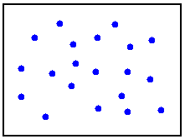
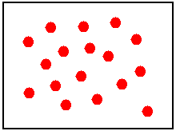
Elements
A sample of lead atoms (Pb). All atoms in the sample consist of lead, so the substance is homogeneous.
A sample of chlorine atoms (Cl). All atoms in the sample consist of chlorine, so the substance is homogeneous.

Slide 7
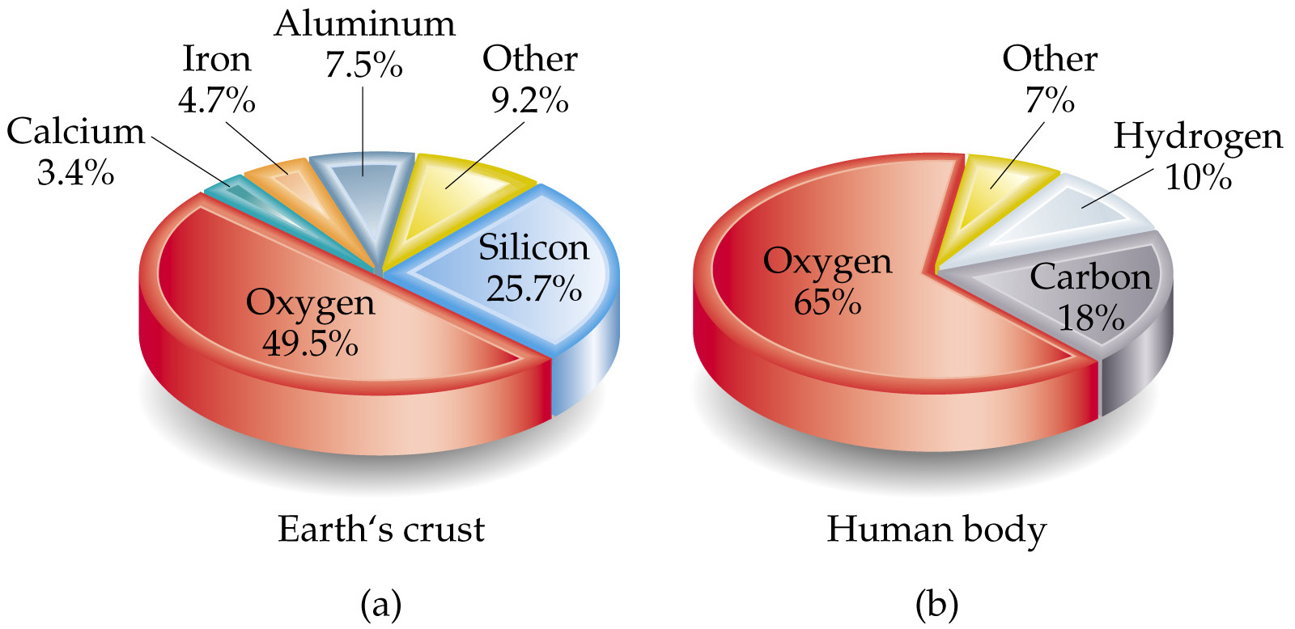
Elements
The earth’s crust consists of 5 main elements.
The human body consists mostly of 3 main elements.
https://www.youtube.com/watch?v=k-KUtd5gaN0

Slide 8
Identifying Elements by their properties.
http://www.glencoe.com/sites/common_assets/science/virtual_labs/E21/E21.html
http://studyjams.scholastic.com/studyjams/jams/science/matter/atoms.htm

Slide 9
Elements are divided in three Major Categories
Metals | Iron, copper | Usually shiny; malleable; ductile; good conductor
Nonmentals | Sulfer, carbon | Dull, brittle; unmalleable; poor conductor
Semimetals(metalloids) | Silicon(used to make computer chips), boron | Have some properties of metals and nonmetals
Noble gases | Helium, neon | Do not combine readily with other elements

Slide 10
Classification of Elements as Metals & Non- Metals
S.No. | METALS | NON- METALS
1 2 3 4 5 | Good conductors of electricity & heat Shiny in appearance Strong & hard Malleable & ductile Sonorous | Bad conductors of heat & electricity Usually dull in appearance Usually weak & soft Brittle Non- Sonorous

Slide 11
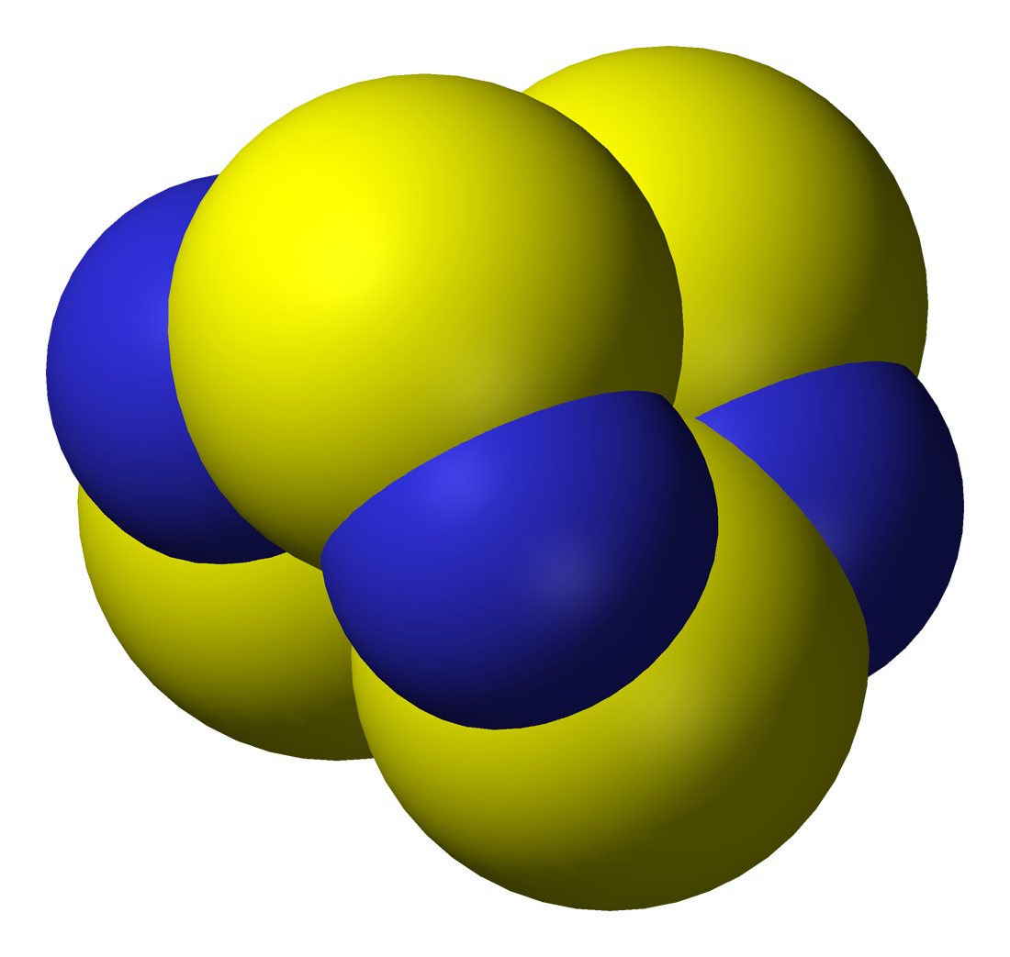
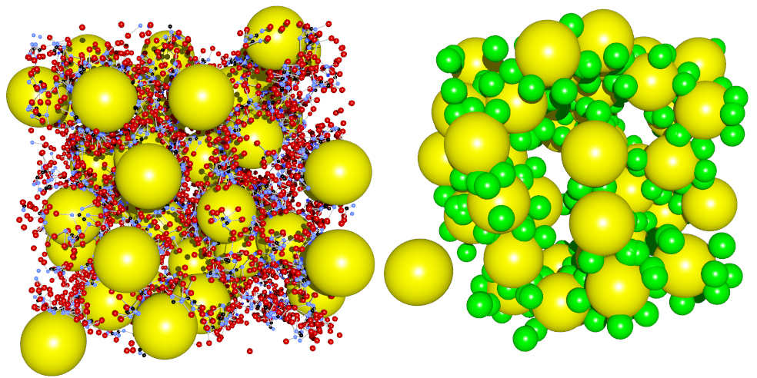
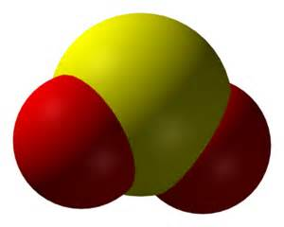
Most things in the universe are made up of mixtures or a compounds.
Mixtures are physically combined
Compounds are chemically combined

Slide 12
Compounds
https://www.youtube.com/watch?v=r3ZiReLYGEM
Most elements react to form compounds.
  Example, H₂O
The proportions of elements in compounds are the same irrespective of how the compound was formed.
  The composition of a pure compound is always the same.
If water is decomposed, then there will always be twice as much hydrogen gas formed as oxygen gas.
.

Slide 13
Mixtures
Heterogeneous mixtures are not uniform throughout.
Homogeneous mixtures are uniform throughout.
Homogeneous mixtures are called solutions.

Slide 14
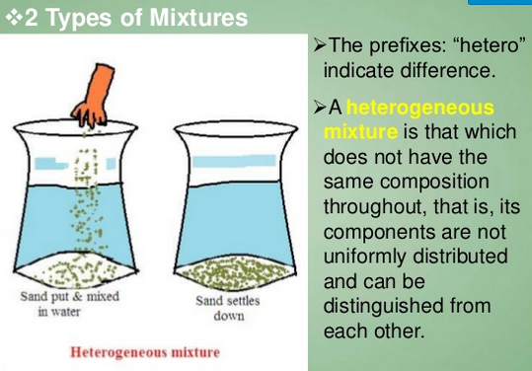
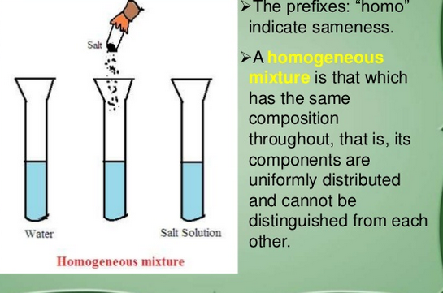
Two Types of Mixtures

Slide 15
CHARACTERISTICS OF MIXTURE
It is an impure substance
No formula
They can be mixed in any ratio.
The properties of the mixture are the properties of its constituents.
Constituents can be easily separated by physical methods e.g. heating, drying, crystallization, distillation etc.
It is either homogenous or heterogeneous.
https://www.youtube.com/watch?v=cL6I1O1YHH0

Slide 16
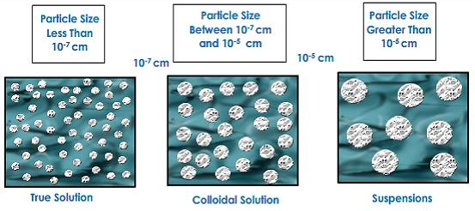
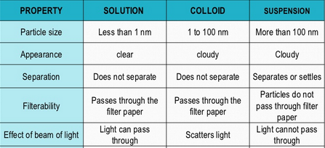
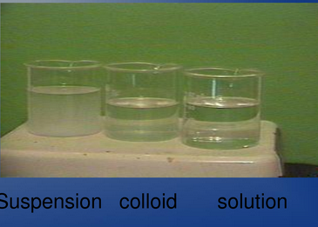
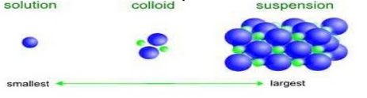
http://www.bbc.co.uk/bitesize/ks3/science/chemical_material_behaviour/compounds_mixtures/activity/

Slide 17
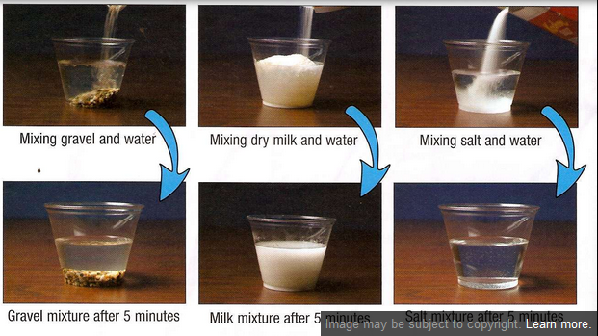
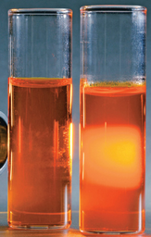
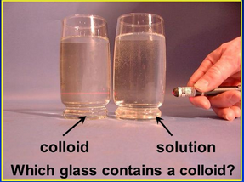
Examples of Mixtures
Solutions: Blood, koolaid, tea
Colloids: smoke, milk cheese, jello
Suspension: snow globe,
“shake well” items, salad dressing

Slide 18
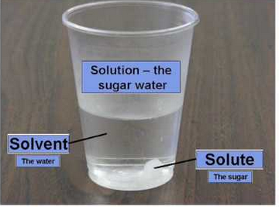
Solutions: Solute and Solvent

Slide 19
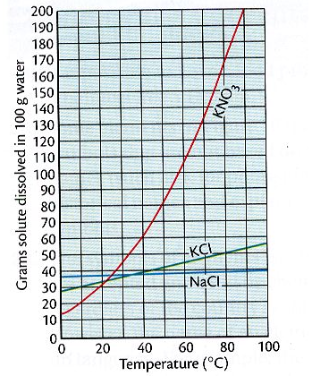
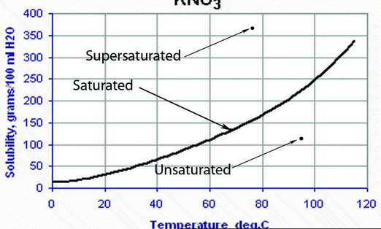
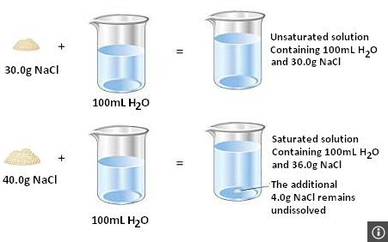
Solubility and Saturation Rates
http://www.glencoe.com/sites/common_assets/science/virtual_labs/PS15/PS15.html

Slide 20
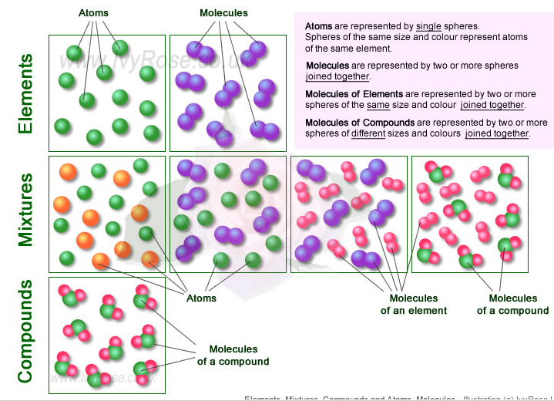
Visuals for how atoms look in elements, compounds and mixtures.

Slide 21
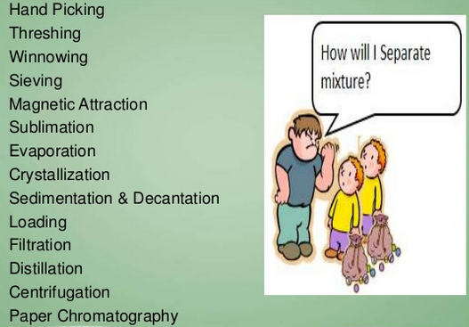
Ways to Separate Mixtures
http://my.hrw.com/sh2/sh07_10/student/flash/virtual_investigations/hst/mix/hst_mix_vi.html

Slide 22
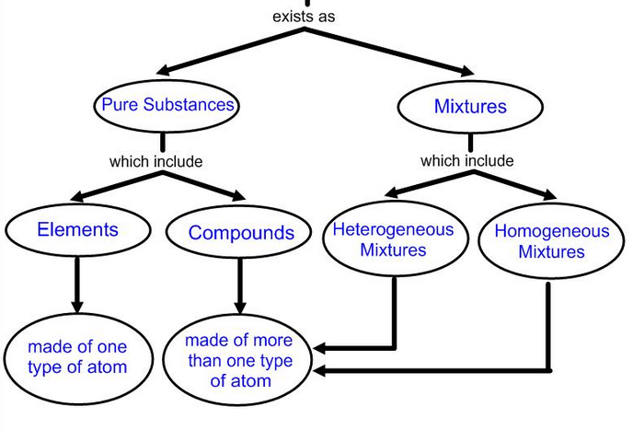
Matter
solutions

Slide 23

Atoms
https://www.youtube.com/watch?v=8ypo6wGqIGY
http://search.tb.ask.com/search/video.jhtml?searchfor=atom+video&cb=UX&pg=GGmain&p2=^UX^xdm423^S10476^us&qid=13872fe8ec364c598ee4e9d2c01d59bd&n=780c6df5&ss=sub&pn=1&st=sb&ptb=5D2DDCE1-0FA6-4F84-8C0E-D872E216D0DE&tpr=&si=245051_JEM-TESTUS&vidOrd=2&vidId=_lNF3_30lUE
http://www.pbslearningmedia.org/resource/phy03.sci.phys.matter.atoms/atoms-the-space-between/
https://www.youtube.com/watch?v=vlSOESXQI7o

Slide 24
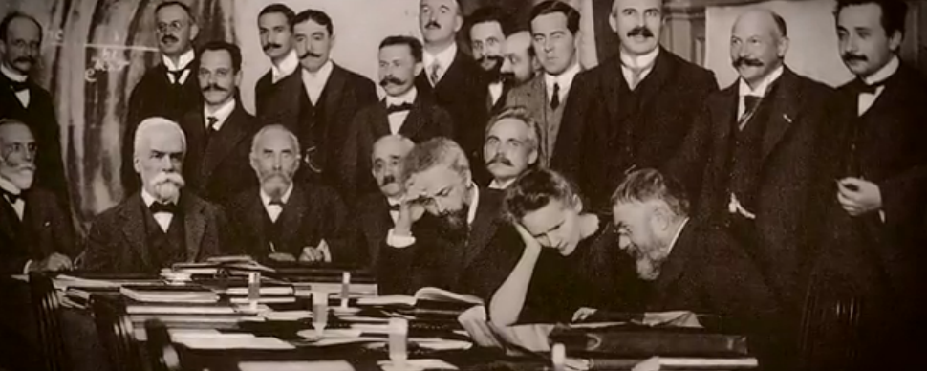
History of the Atoms
http://video.pbs.org/video/2365543501/

Slide 25
Atomic Structure
https://www.youtube.com/watch?v=EMDrb2LqL7E
https://www.youtube.com/watch?v=sRPejoNktKE
https://phet.colorado.edu/sims/html/build-an-atom/latest/build-an-atom_en.html

Slide 26
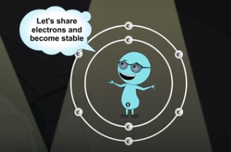
Bonding of Atomshttp://search.tb.ask.com/search/video.jhtml?searchfor=colvaent+bonding+video&cb=UX&pg=GGmain&p2=^UX^xdm423^S10476^us&n=780c6df5&qid=116a7e219f164b5b895f9b7c55adeecf&ss=sub&pn=1&st=sb&ptb=5D2DDCE1-0FA6-4F84-8C0E-D872E216D0DE&tpr=&si=245051_JEM-TESTUS&vidOrd=2&vidId=QXT4OVM4vXI
Chemical Bonding
Covalent bonding
Ionic bonding

Slide 27
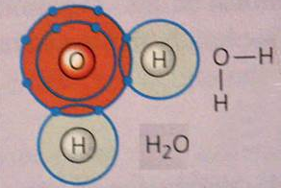
Covalent Bonding of elements
Covalent Bonding: Share electrons- usually same element or have some common properties
https://www.youtube.com/watch?v=G9K6PMGt4LM
http://search.tb.ask.com/search/video.jhtml?searchfor=colvaent+bonding+video&cb=UX&pg=GGmain&p2=^UX^xdm423^S10476^us&n=780c6df5&qid=116a7e219f164b5b895f9b7c55adeecf&ss=sub&pn=1&st=sb&ptb=5D2DDCE1-0FA6-4F84-8C0E-D872E216D0DE&tpr=&si=245051_JEM-TESTUS&vidOrd=2&vidId=QXT4OVM4vXI

Slide 28
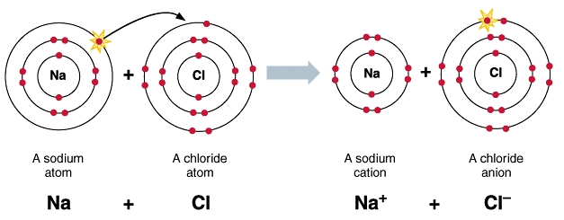
Ionic Bonding
Ionic Bonding: a lost or gain of electrons and changing the charge to positive or negative
leaving the two atoms attracted to each other. This occurs between metal and nonmetal atoms.
https://www.youtube.com/watch?v=Qf07-8Jhhpc
https://www.youtube.com/watch?v=DEdRcfyYnSQ

Slide 29
Periodic Table
http://studyjams.scholastic.com/studyjams/jams/science/matter/periodic-table.htm
https://www.youtube.com/watch?v=uPkEGAHo78o
http://www.periodictable.com/
https://www.youtube.com/watch?v=YdXuSftZELQ

Slide 30
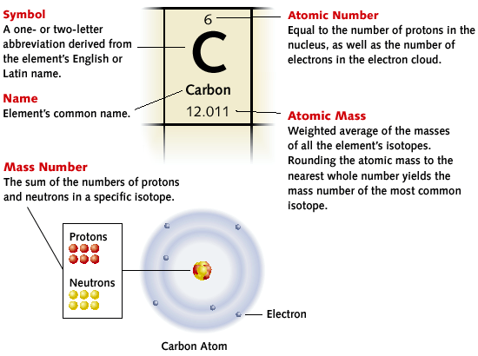
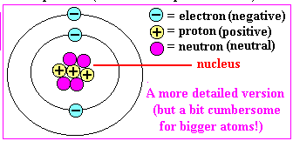
How to read a periodic table

Slide 31
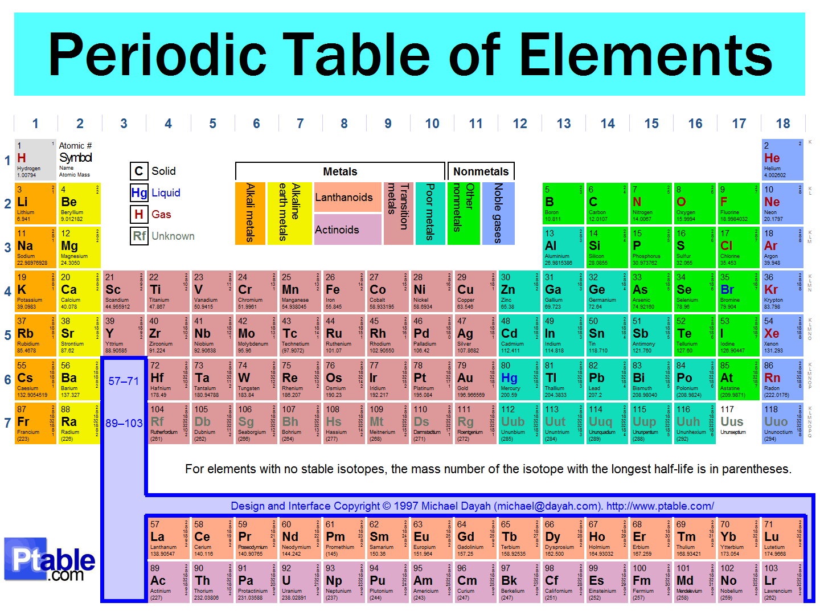
The universe is made up of Elements and Atoms
https://www.bing.com/videos/search?q=asap%20science%20periodic%20table%20song&qs=VI&form=QBVR&pq=asap%20science%20&sc=8-13&sp=7&sk=VI6#view=detail&mid=6A38B09D9237BDC9F3BD6A38B09D9237BDC9F3BD

Slide 33
How to tell how many atoms are in a compound.
C$O_{2}$
$$H_{2}{SO}_{4}$$
Fe$C_{4}{Cl}_{5}$
Br$O_{2}$
http://quizlet.com/1880999/names-and-formulas-of-chemical-compounds-flash-cards/

Slide 34
graphene
https://www.youtube.com/watch?v=SXmVnHgwOZs
https://www.youtube.com/watch?v=EX8ClPVkD1g

