Slide 1

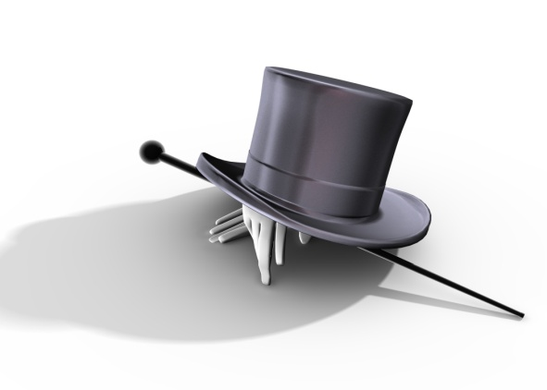

The President wears many hats.
Nine (9) to be exact!
Highlight key words in each of the 9 parts that may help you to identify the hat he wears.

Slide 2
Here are the titles he is given, put the initials to the left of the one you think it matches.
CHIEF EXECUTIVE HEAD OF STATE CHIEF DIPLOMAT
CE HS CD
COMMANDER and CHIEF ECONOMIC LEADER CHIEF LEGISLATOR
CHIEF CC CEL CL
CHIEF PARTY LEADER PEOPLES REPRESENTATIVE HUSBAND & FATHER
CP PR HF

Slide 3
.
Day in the Life of the President
Watch the movie clip:
http://www.nbcnews.com/id/31050780/ns/politics-white_house/t/day-life-obamas-white-house
Write down at least 3 examples, from the movie, of things the President does that correspond to the roles we just discussed.
On the index card answer the “I can” statement, the roles of the President are like my wardrobe because……

Slide 4
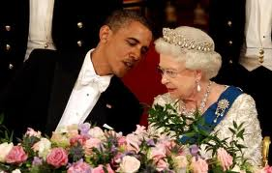
Head of State
Our nation’s official host to foreign dignitaries.
Bestows medals and ceremonial activities.
Represent the United States.

Slide 5
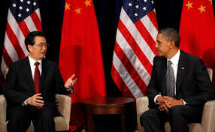
Chief Diplomat
Approve the general direction of American foreign policy.
Initiate and negotiate treaties.
Recognize countries, accept and send ambassadors.

Slide 6
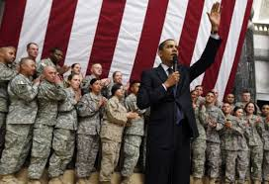
Commander and Chief
The “Super General” and “Super Admiral” for the U.S. Military.
Can ask Congress for Declaration of War.
Launch atomic warfare.
Send troops to stop revolts inside our country.

Slide 7
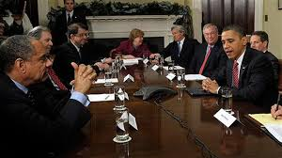
Chief Executive
Execute (carry out) the laws passed by Congress.
Appoint people to departments to enforce laws.
Day-to-Day duties of a leader.

Slide 8
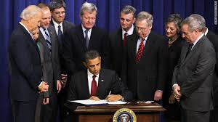
Chief Legislator
Power to veto legislation.
Initiate ideas for laws to Congress.

Slide 9
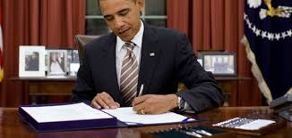
Chief Economic Planner
Ensure the economy runs smoothly.
Plan for the national budget.
Create programs for the coming fiscal year.

Slide 10
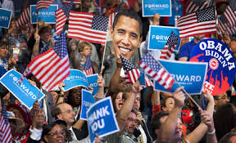
Chief Party Leader
Head of his political party.
Work to strengthen the Party.

Slide 11
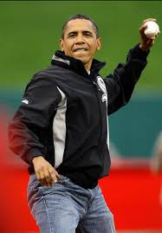
Representative of the People
Must consider the needs of the entire nation.
Identify the national interest and promote it.

Slide 12
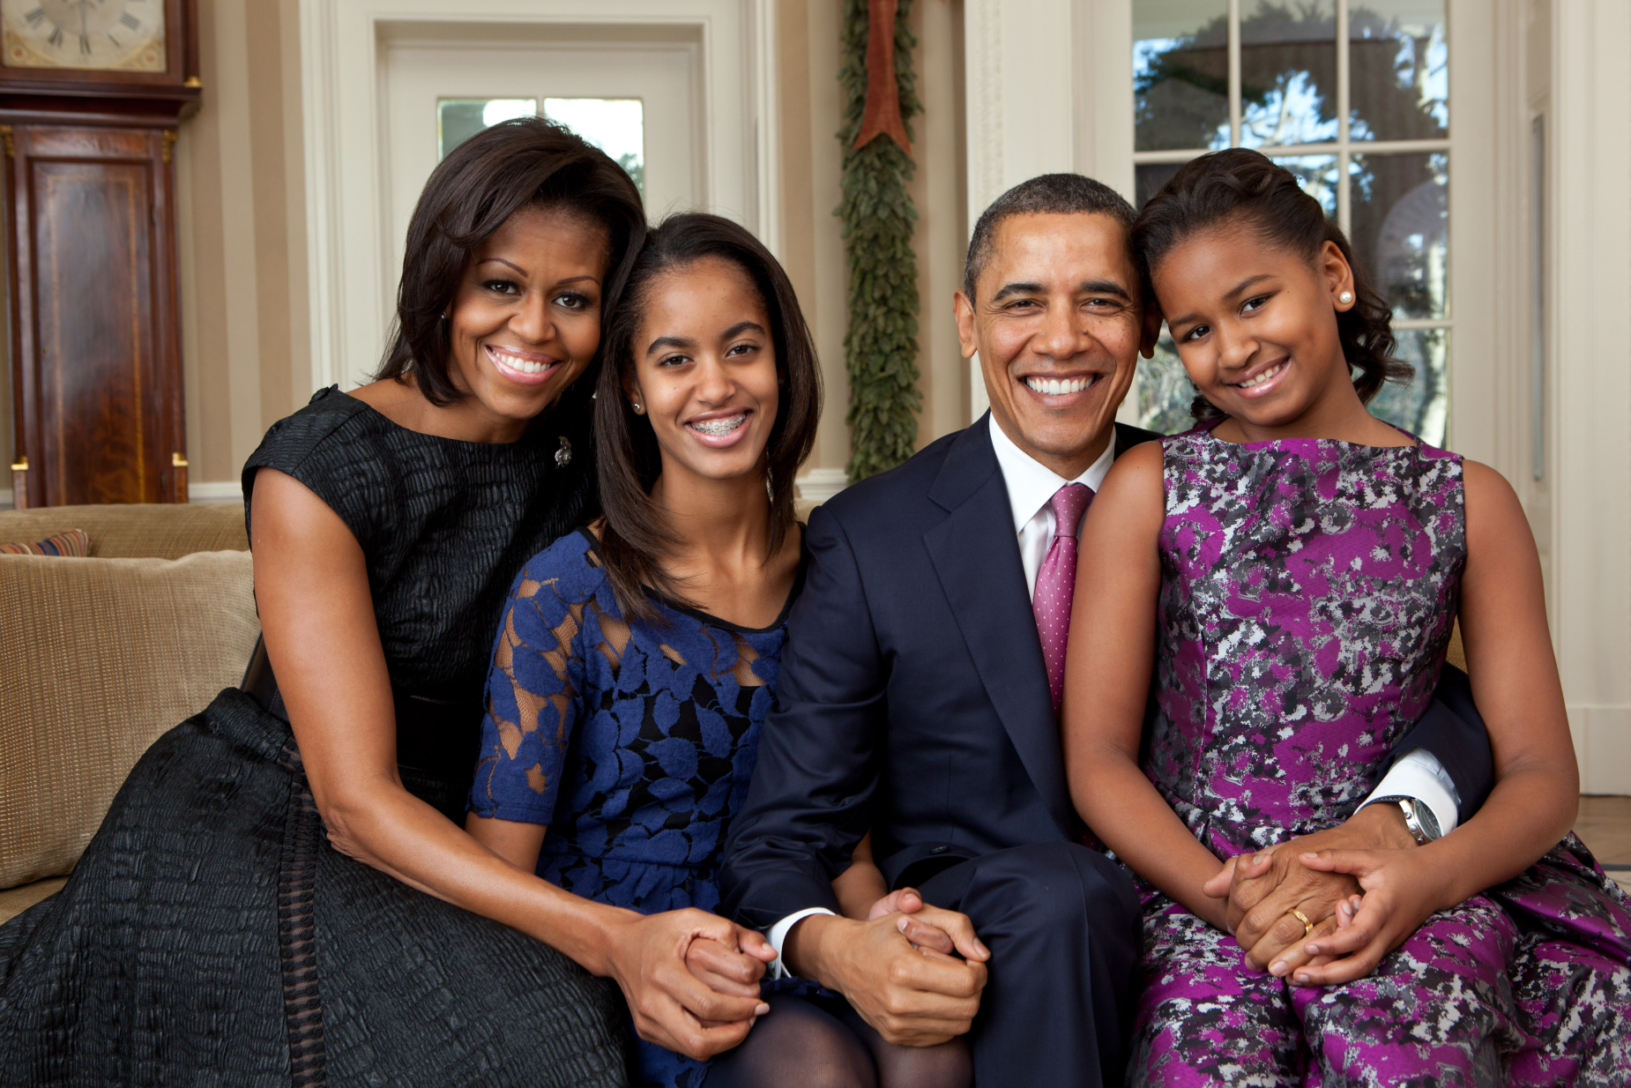
Father and Husband

Slide 13
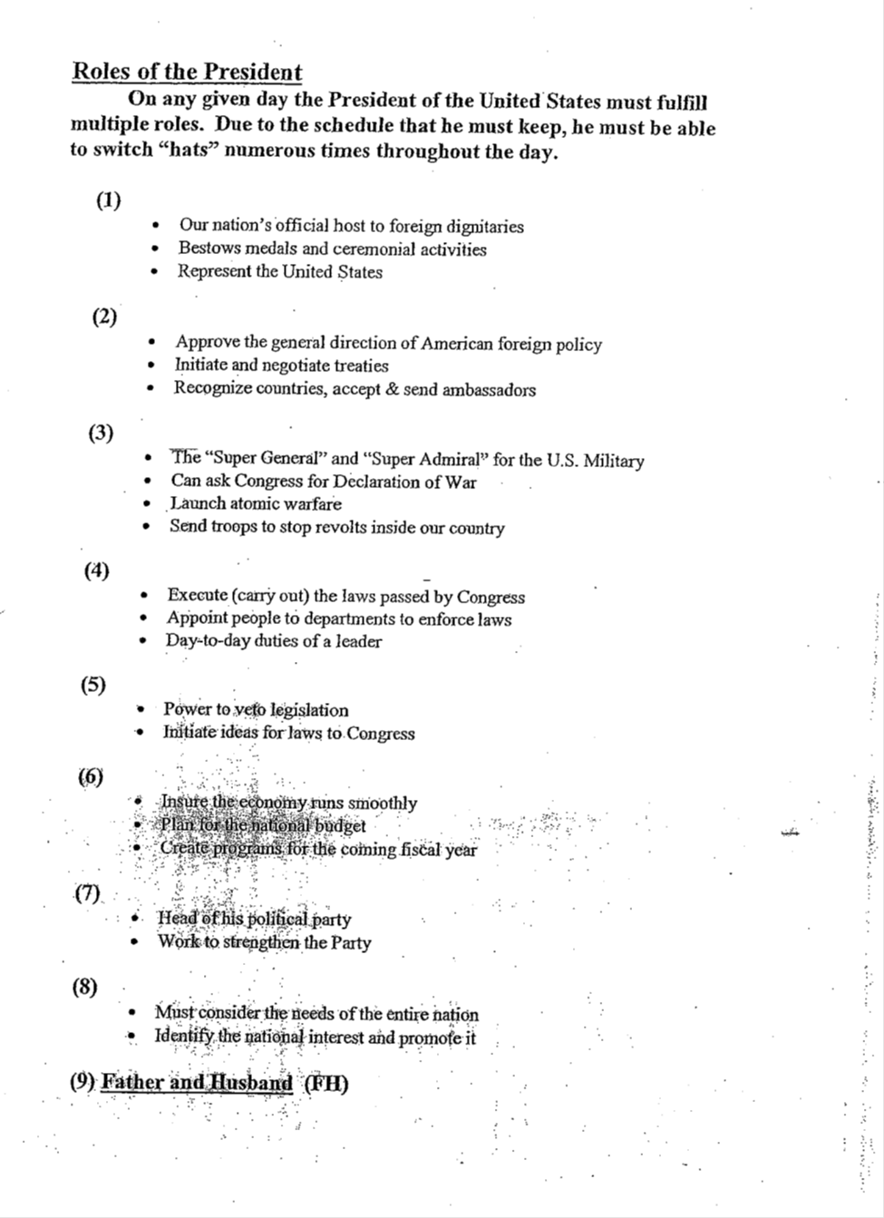
Head of State
Chief Diplomat
Commander in Chief
Chief Executive
Chief Legislator
Chief Economic Planner
Chief Party Leader
Representative of the people.

